Slide 1
Week 9
NyxusByte Internship(Python)
Presented By:
Anish Bista

Slide 2
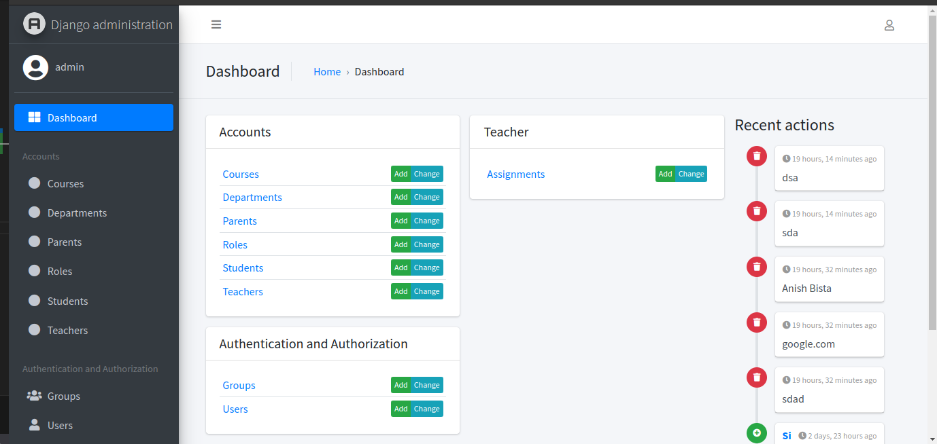
What we accomplished this week?
Completed:
Admin

Slide 3
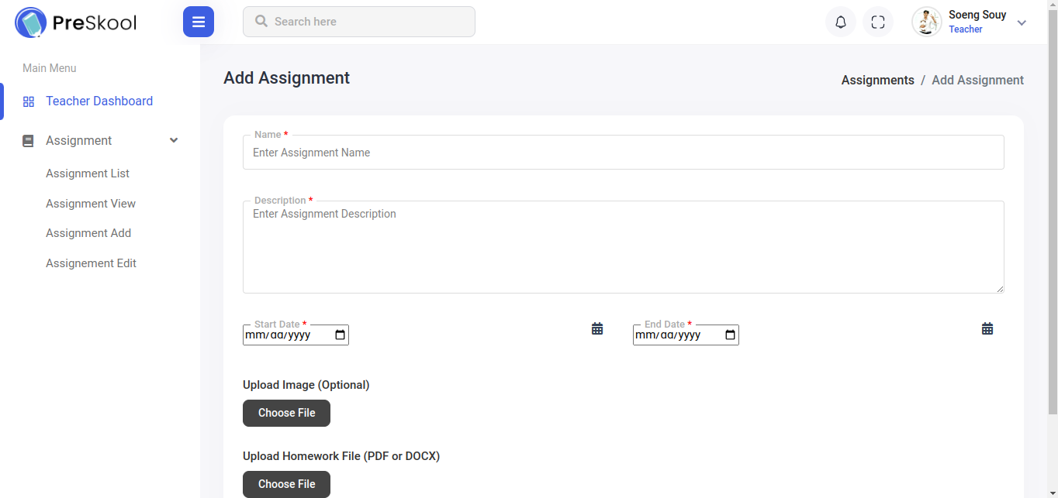
What we accomplished this week?
Ongoing:
Teacher

Slide 4
Challenges:
Time Management
Difficult while merging branches
Integrating front end files

Slide 5
Thank You !!

